Slide 1
Welcome to Blazor
张善友
Notes:
BETH TODO: Add a little context on what these “Focus” events are and that we’ll be bringing you more in the coming year….

Slide 2


.NET
Your platform for building anything
Desktop
Web
Cloud
Mobile
Gaming
IoT
AI
Notes:
You can build anything with .NET.
We’ve made significant investments in .NET over the years as well as unifying the ecosystem to support building literally anything. From desktop to gaming to the cloud, .NET is a general purpose programming platform that enables all kinds of application scenarios. Once you learn one, you can easily pick up another.

Slide 3
.NET Growth Continues
>1 million
>100
thousand
Fastest adopted version
.NET Core developers
Accepted community PRs
.NET Core 3
Notes:
And the platform keeps growing!
We’ve seen significant growth with .NET Core, our open source, cross-platform .NET, now has surpassed 1 million active developers per month.
And our open source repos are some of the most active on all of GitHub. We’ve accepted over 100 thousand pull requests from the community as we’ve built the platform together.
And .NET Core 3, released at .NET Conf in September, has been the fastest adopted for any version, EVER.
<CLICK>

Slide 4

RELEASED
.NET Core 3.1
Long-Term Support (LTS)
WPF and Windows Forms support
Side-by-side support & self-contained EXEs
New C# 8.0 language features
Blazor: Full-stack web development with C# and Razor
dot.net/get-core3
Notes:
.NET Core 3.1 released last month so go get it!
We’ve added Windows Desktop support with Windows Forms and WPF support. This brings the capabilities of .NET Core to these UI frameworks. Particularly, flexible deployment with side-by-side and self-contained EXEs so you don’t have to have .NET installed on the machine first anymore.
We also have some exiting new things for Web developers with Blazor, which is what we’ll be talking about ALL DAY!, adding full-stack web development with C# and Razor, allowing you to build beautiful and responsive Single Page Apps without having to write JavaScript!
Additionally we have a ton of improvements for building better cloud native, scalable apps and services with ASP.NET as well as some exciting C# 8.0 language features.
<CLICK>

Slide 5





PARTNERS
Partner Tools and Controls for Blazor
Notes:
.NET has a rich ecosystem of partners building additional tools and controls to help you build beautiful, full-featured, applications faster.
We have many partners releasing support for Blazor in their tools and controls today as well. SyncFusion, Radzen, Progrss Telerik, Infragistics and DevExpress.
THANK YOU!!
<CLICK>

Slide 6










ANNOUNCED
.NET Foundation Corporate Sponsor
dotnetfoundation.org/blog
Notes:
We’re also very happy to see the .NET Foundation announced that DevExpress has joined as a corporate sponsor! DevExpress joins the group of corporations that are helping drive the future of the .NET platform and ecosystem. Check out the .NET Foundation blog for more info.
<CLICK>

Slide 7
What is Blazor?

Slide 8






https://...
.NET
JS

Slide 9


Blazor
Build client-side web UI with .NET instead of JavaScript
Write reusable web UI components with C# and Razor
Share .NET code with both the client and the server
Call into JavaScript libraries & browser APIs as needed
C#

Slide 10
How Blazor works
Blazor Server
https...
ASP.NET Core
SignalR
DOM
Razor Components
.NET
.NET Core 3.1 LTS

Slide 11
How Blazor works
Blazor WebAssembly
https://...
Razor Components
DOM
.NET
WebAssembly
Preview

Slide 12
Shared component model
Blazor Server
Blazor WebAssembly
https...
https://...
ASP.NET Core
Razor Components
DOM
SignalR
DOM
.NET
Razor Components
WebAssembly
.NET
.NET Core 3.1 LTS
Preview

Slide 13

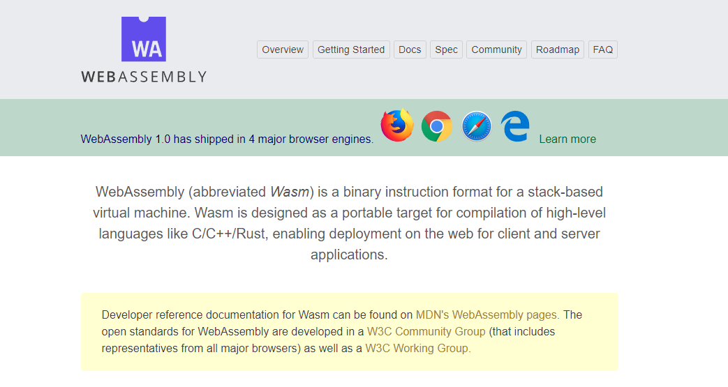
WebAssembly.org
文档: https://webassembly.org/docs/high-level-goals/

Slide 14









WebAssembly Working Group https://bit.ly/32yDOCP
Members from industry leaders:

Slide 15
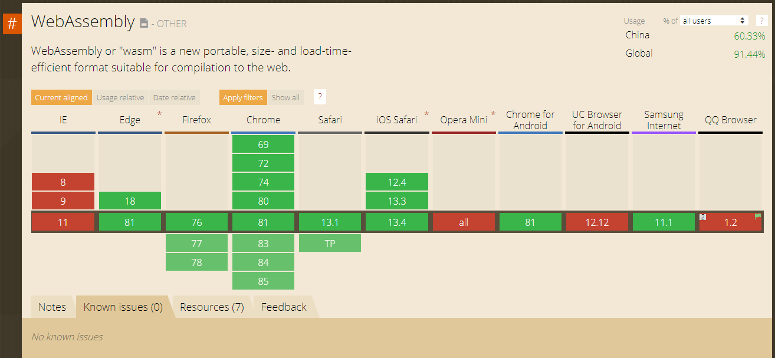
WebAssembly 兼容性
Source: https://caniuse.com/#search=wasm

Slide 16

WebAssembly 工作原理
.NET Standard 2.1 构建
Delivered to browser
WASM alongside JS/HTML/CSS
MyBlazorClient.dll
MyBlazorClient.dll
JS
mono.wasm + Supporting files
dotnet.wasm + Supporting files
Referenced Assemblies
Referenced Assemblies
Referenced Assemblies
Referenced Assemblies
HTML
CSS
Referenced Assemblies
Referenced Assemblies

Slide 17




Get started with Blazor
Go to https://blazor.net
Install .NET Core 3.1
Install the Blazor WebAssembly template
Visual Studio
2019 16.4
Visual Studio for Mac
8.4
Visual Studio Code
+ C# extension

Slide 18
Blazor in Action
Notes:
Creating components
Using components
Component parameters
Routing
Layouts
Dependency injection
Event handling
Data binding
Forms & validation
Using .NET Standard libraries

Slide 19
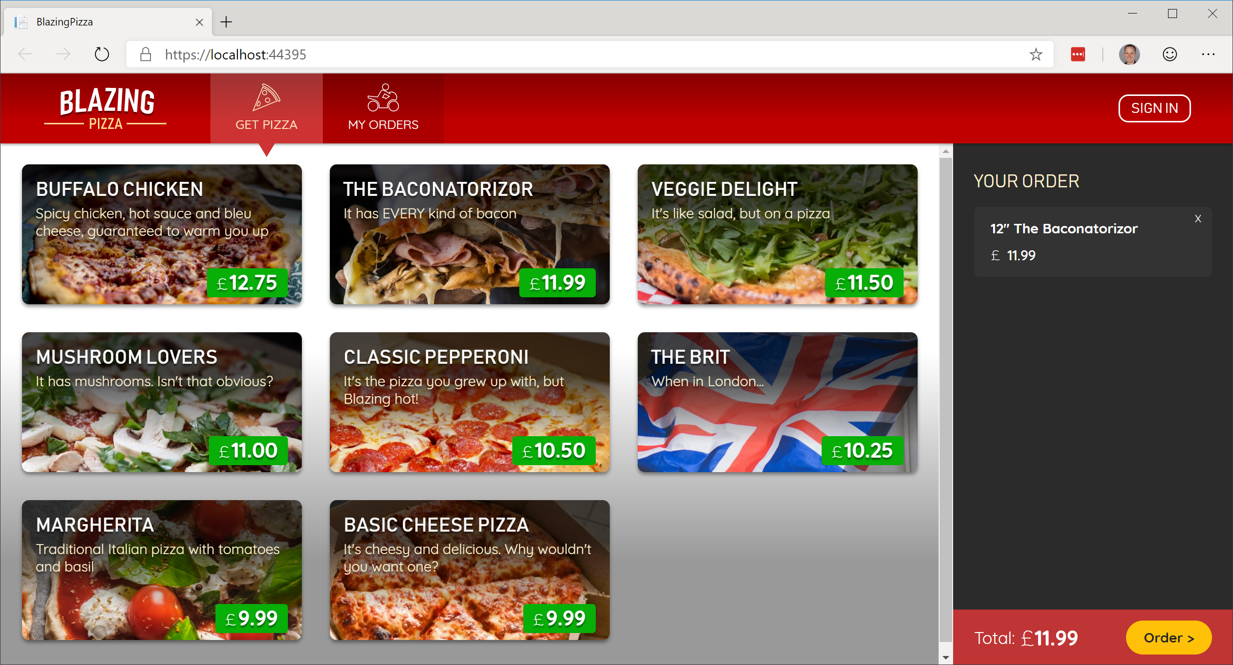
Build your own pizza store UI with Blazor
https://aka.ms/blazorworkshop

Slide 20
Blazor Server at scale
We test for appropriate latency (<200ms) under load with active concurrent clients (1 click / sec)
Available memory is the primary bottleneck
Real app behavior will depend on app memory usage, client behavior, and network conditions
Instance size | Concurrent active users
Standard_D1_v2 (1 vCPU, 3.5 GB) | 5,000+
Standard_D3_V2 (4 vCPU, 14 GB) | 20,000+

Slide 21


What companies using Blazor are saying…
“Pivotal is all about speeding up the path to production. That's why it invests in Steeltoe to provide its customers with a quick and easy way to build cloud-native .NET apps. And why we chose Blazor to create the Steeltoe website – Blazor makes it simple to design websites using C#.”
– David Dieruf, Product Marketing Manager, Pivotal Software
"We’re really impressed with .NET Core 3.1 and Blazor which has boosted our productivity, vastly improved the quality of our front-end code, and significantly reduced the amount of Javascript in our application to just 51 lines of code.“
– Matheus Guimaraes, Co-Founder & CTO at Deployed.

Slide 22


What companies using Blazor are saying…
"We're extremely happy with Blazor as the UI for our broadcast TV equipment. Blazor server made it simple to render data from our hardware subsystems and we were able to rapidly develop a unified front-panel and remote UI for use on a range of products."
– Will Dean, Product Development Engineer, Videosys Broadcast
“BST Global is a leader in delivering innovative ERP and business management software solutions for the Architectural, Engineering and Consulting industry. We are currently exploring the use of Blazor technology with BST’s .NET Extensibility Platform and API to support its future web surface strategy because it keeps our developers more productive in C#.”
– Darren Johnson, Sr. Manager Software Engineering, BST Global

Slide 23
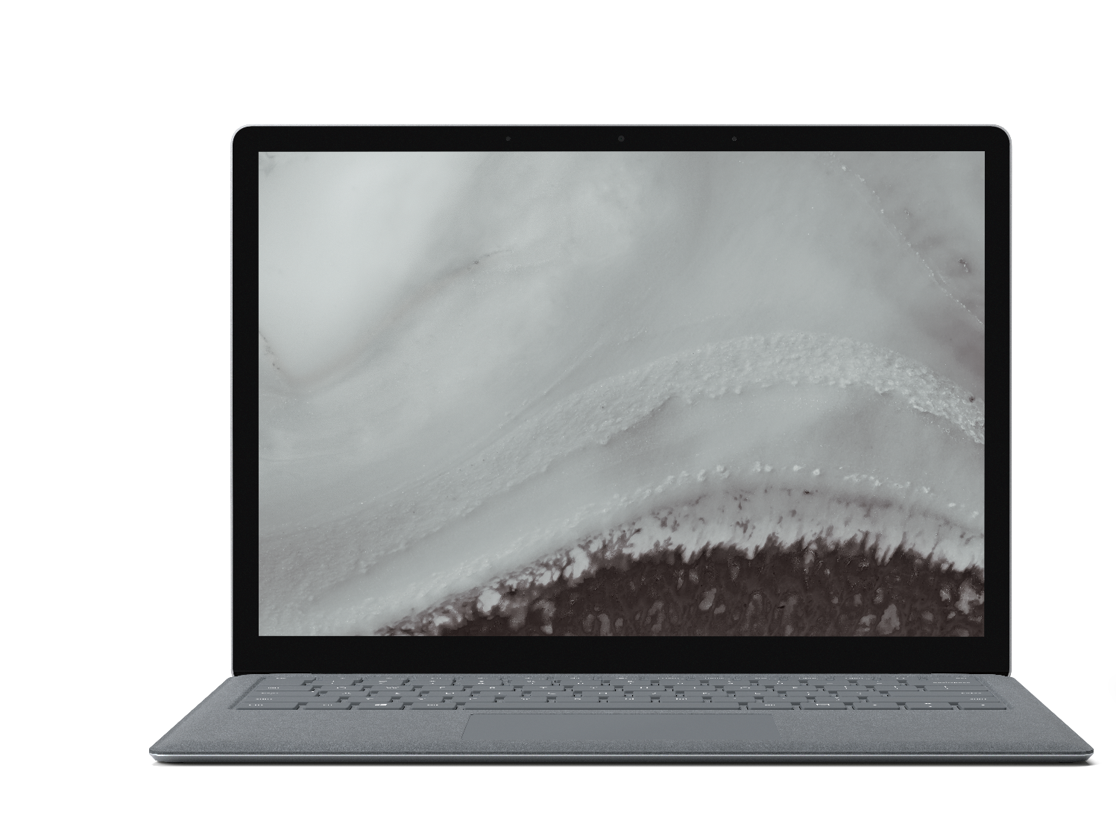
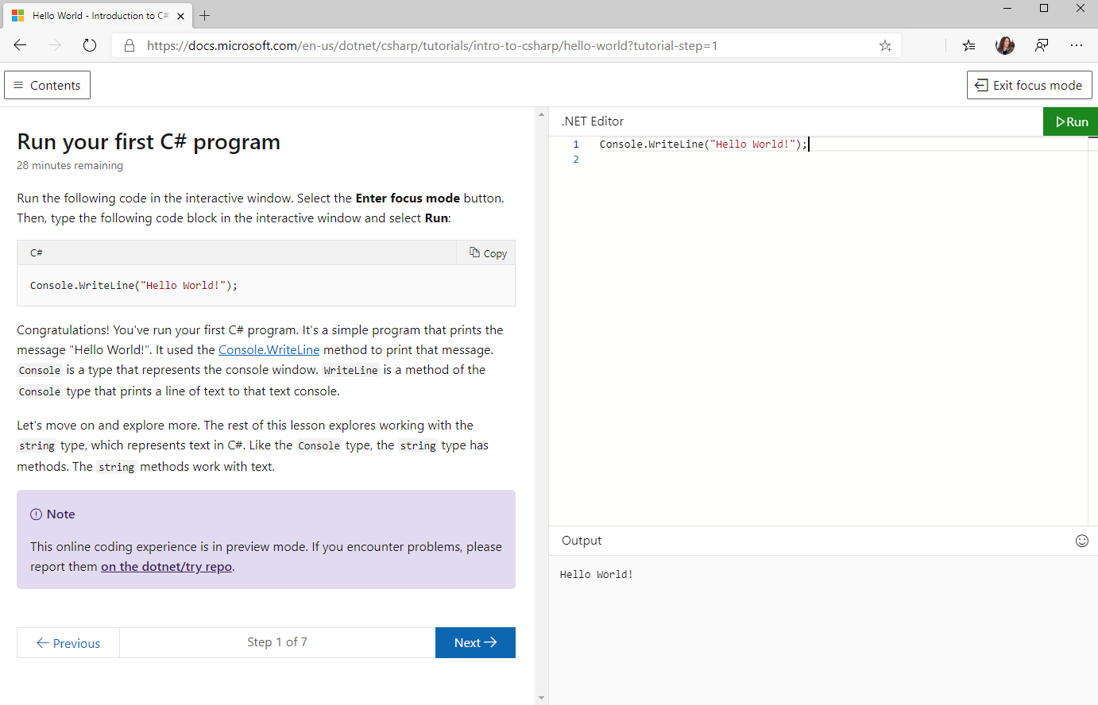
Try .NET
Try out C# and .NET with just a browser
Runs your code locally with Blazor WebAssembly
Dramatically reduced the cost of backend infrastructure
aka.ms/csharpintro

Slide 24
The Awesome Blazor community
https://aka.ms/awesomeblazor
Free open-source components & JS interop libraries
Lots of fun sample Blazor apps
Articles, videos, blogs, and other learning materials
Chat with the Blazor community on Gitter: https://gitter.im/aspnet/blazor

Slide 25
Blazor Futures

Slide 26
Web
Blazor Server
Web app
Every interaction handled on server
Prerendered HTML (optional)
Blazor WebAssembly
Web app with client-side execution
Loaded from web server
Can work offline via Service Worker
Blazor PWA – OS installed
Appears as native app (own window)
Works offline or online
Blazor Hybrid
Native .NET renders to Electron / WebView
Appears as native app (own window)
Works offline or online
Desktop
+ Mobile
Blazor Native
Same programming model, but
rendering non-HTML UI

Slide 27
Blazor WebAssembly
Current focus for the Blazor team
Release in May 2020
Initial release based on .NET Core 3.1
Template will ship in a .NET Core 3.1 SDK update
Will be a Current release, not an LTS release
Packages will be versioned as 3.2
After May, Blazor WebAssembly will move into .NET 5 and be part of the normal release train

Slide 28
Blazor WebAssembly features for May
.NET Standard 2.1
WebSockets + .NET SignalR client
Debugging (browser dev tools & Visual Studio)
Auto-rebuild
IL trimming
Brotli compression
Static web assets integration
Authentication options
Localization

Slide 29
Blazor Hybrid experiments
Blazor + Electron
https://aka.ms/blazorelectron
Blazor + WebWindow
https://aka.ms/webwindow
Exploring Blazor Hybrid scenarios is a major theme for .NET 5

Slide 30


ANNOUNCING
Experimental Mobile Blazor Bindings
Build native mobile apps with Blazor
Use your familiar web skills: Razor, C#, CSS
Rich set of native mobile components
100% access to native APIs: GPS, Media, & more
Use existing ecosystem of NuGet libraries for mobile
All in .NET
aka.ms/mobileblazorbindings
Notes:
Use familiar web skills: Razor, C#, CSS
Rich set of native controls
Use the already vast ecosystem of .NET libraries for mobile
100% Access to Native APIs like GPS, sensors, bluetooth, media playback and media libraries, keyboard, and on and on
All in .NET (ie no req for other languages)
Powered by Xamarin
This is a first step in an experiment. To learn more, check out Eilon Lipton's session later today at 1pm PT. We hope you'll go hands-on with this and share your feedback.

Slide 31
.NET Schedule
May 2020
Blazor WebAssembly
Sept 2019
.NET Core 3.0
Nov 2019
.NET Core 3.1
LTS
Nov 2020
.NET 5.0
Nov 2021
.NET 6.0
LTS
Nov 2022
.NET 7.0
Nov 2023
.NET 8.0
LTS
.NET Core 3.0 released at .NET Conf in September
.NET Core 3.1 = Long Term Support (LTS)
.NET 5.0 release in November 2020
Major releases every year, LTS for even numbered releases
Predictable schedule, minor releases if needed

Slide 32
Summary
Build full-stack web apps with C# and .NET
Rich component model and UI framework
Integrates with existing ASP.NET Core apps
Blazor Server in .NET Core 3.1 LTS is production ready
Blazor WebAssembly coming in May 2020
Try out new Blazor Hybrid & Native experiments
Get start with https://blazor.net today!

